Slide 1
Design, Prototyping and Construction
Sara Muneeb
sara.muneeb@cuilahore.edu.pk
Computer Science Department

Slide 2
Introduction
There are two aspects to design:
The conceptual part
which focuses on the idea of a product
It captures what the product will do
The concrete aspect
which focuses on the details of the design how it will behave
it is concerned with the details of the design, such as menu types, haptic feedback, physical widgets, and graphics
For users to evaluate (feedback) the design of an interactive product effectively, designers prototype their ideas.

Slide 3
Conceptual Design
Conceptual design is concerned with developing a conceptual model.
Conceptual model is an outline of what people can do with a product and which concepts are needed for the user to understand how to interact with it.
The former will emerge from an understanding of the problem space and the current functional requirements.

Slide 4
Steps
Use different creativity and brainstorming techniques to explore ideas with other team members
Use scenarios and prototypes to capture and do experiment with ideas.
Use ready-made components to increases the ease with which ideas can be prototyped
Explore different conceptual models and design ideas.
Do until desired users’ experience emerges and become more concrete.
Example: Mood boards (traditionally used in fashion and interior design) may be used to capture the desired feel of a new product.

Slide 5
Developing the Initial Conceptual Model
The core components of the conceptual model are
metaphor and analogies,
the concepts to which users are exposed
the relationship between those concepts
the mappings between the concepts and user experience being supported
Initial conceptual models may be captured in wireframes.

Slide 6

Developing the Initial Conceptual Model
Initial conceptual model considers the following:
How to choose interface metaphors that will help users understand the product?
Which interaction type(s) would best support the users’ activities?
Do different interface types suggest alternative design insights or options?

Slide 7

Interface Metaphors
Interface metaphors combine familiar knowledge with new knowledge in a way that will help users understand the product.
It is based on an understanding of the users and their context.
A metaphor is only a partial mapping between the product and the real thing upon which the metaphor is based.

Slide 8
Steps to Create Metaphors
The first step is to understand what the system will do
identify functional requirements.
The second step is to understand which bits of the product are likely to cause users problems
which tasks or subtasks cause problems, are complicated, or are critical.
The third step is to generate metaphors
Tom Erickson (1990)

Slide 9
Evaluation of Metaphor
How much structure does the metaphor provide?
How much of the metaphor is relevant to the problem?
Is the interface metaphor easy to represent?
Will your audience understand the metaphor?
How extensible is the metaphor? Does it have extra aspects that may be useful later?

Slide 10
Interaction Types
Five different types of interaction:
Instructing
Conversing
Manipulating
Exploring
Responding
Which type of interaction is best suited to the current design depends on the application domain and the kind of product being developed.

Slide 11
Interface Type
When thinking about the conceptual model for a product, it is important not to be unduly influenced by a predetermined interface type.
Different interface types prompt and support different perspectives on potential user experiences and possible behaviors, hence prompting alternative design ideas.

Slide 12
Class Activity
Consider the new navigation app for a large shopping center,
Identify tasks associated with this product that would best be supported by each of the interaction types instructing, conversing, manipulating, exploring, and responding.
Pick out two interface types that might provide different perspectives on the design.

Slide 13
Expanding the Initial Conceptual Model
For prototyping or testing with users, initial conceptual ideas need some expansion like
What functions the product will perform?
What function the user will perform?
How all the functions are related to each other?
What information (data) is required to support the task?

Slide 14
Concrete Design
Concrete design deals with the
Visual appearance
color and graphics, icon design, button design
Interface layout
Choice of interaction devices
Interface type
Usability and user experience goals
User characteristics and context
Accessibility and inclusiveness

Slide 15
Prototyping
Prototyping provides a concrete manifestation of an idea—whether it is a new product or a modification of an existing one.
Prototype is one manifestation of a design that allows stakeholders to interact with it and to explore its suitability.

Slide 16
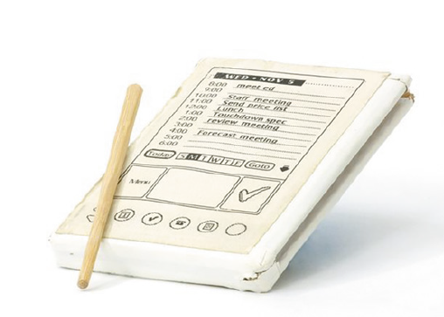
Prototyping
A prototype can be anything from a paper-based storyboard to a complex piece of software.
The PalmPilot wooden prototype

Slide 17
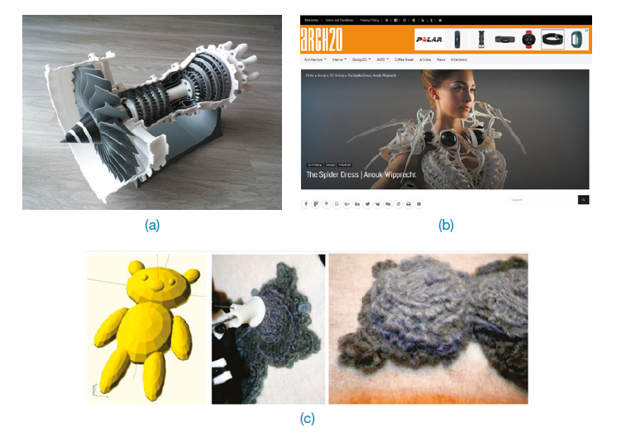
Example

Slide 18
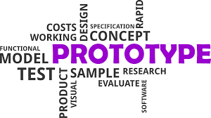
Why Prototype?
Prototypes are useful when discussing or evaluating ideas with stakeholders; they are a communication device among team members and an effective way for designers to explore design ideas.

Slide 19
Why Prototype?
Prototypes answer questions and support designers in choosing between alternatives.
to test the technical feasibility of an idea
to clarify some vague requirements
to do some user testing and evaluation
to check that a certain design direction is compatible with the rest of product development.
The purpose of a prototype will influence the kind of prototype that is appropriate to build.

Slide 20
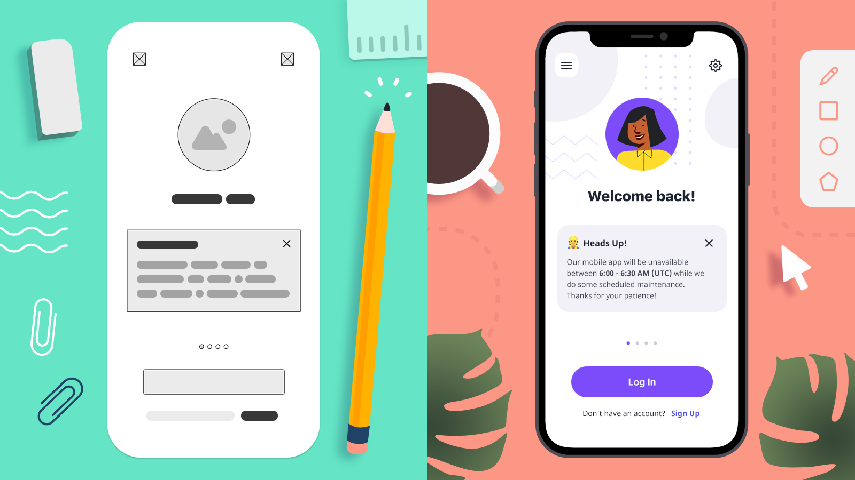
Types of Prototypes
Low Fidelity Prototype
High Fidelity Prototype
Low Fidelity Prototype
High Fidelity Prototype

Slide 21
Low Fidelity Prototype
A low-fidelity prototype does not look very much like the final product, nor does it provide the same functionality.
LFP tend to be simple, cheap, and quick to produce and modify.
LFP support the exploration of alternative designs and ideas.
LFP are not meant to be kept and integrated into the final product.

Slide 22
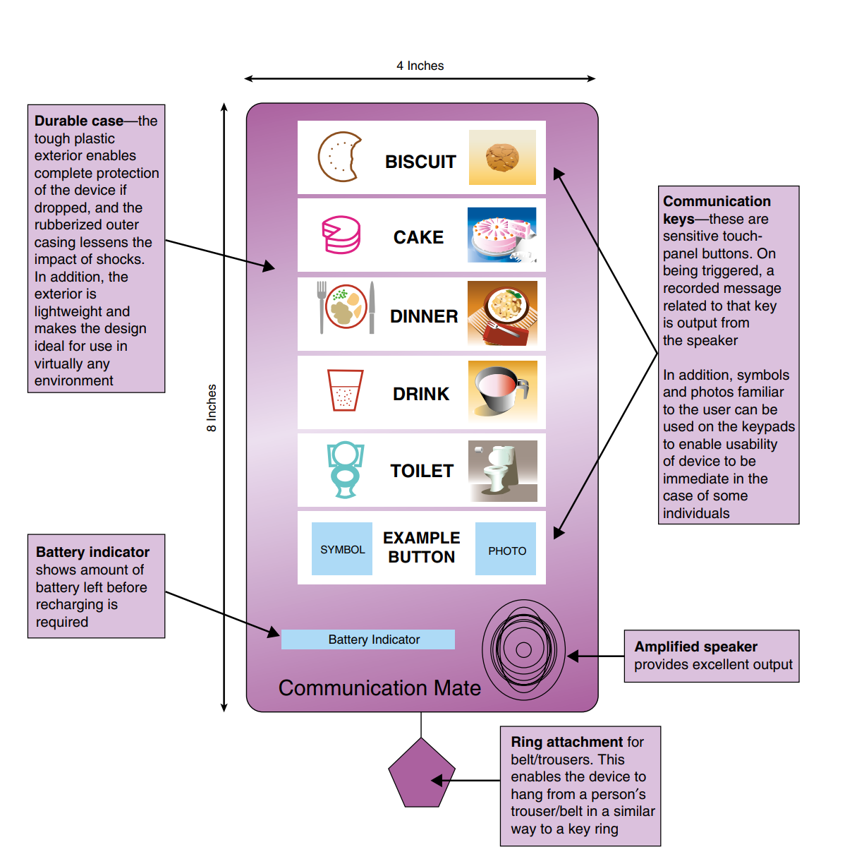
Example
A paper-based prototype of a handheld device to support an child with autism

Slide 23
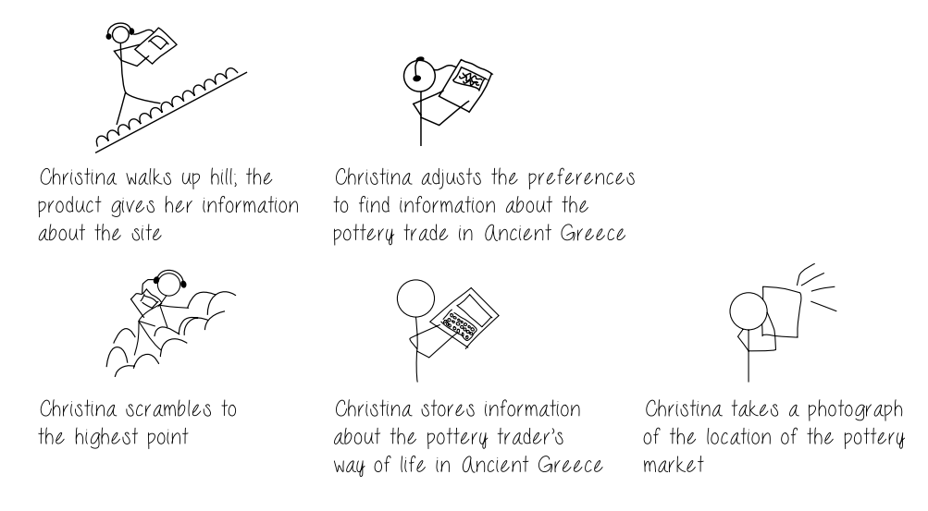
Storyboarding – LFP
A storyboard consists of a series of sketches showing how a user might progress through a task using the product under development
Storyboarding is one example of low-fidelity prototyping that is often used in conjunction with scenarios
An example storyboard for a mobile device to explore ancient sites such as The Acropolis

Slide 24
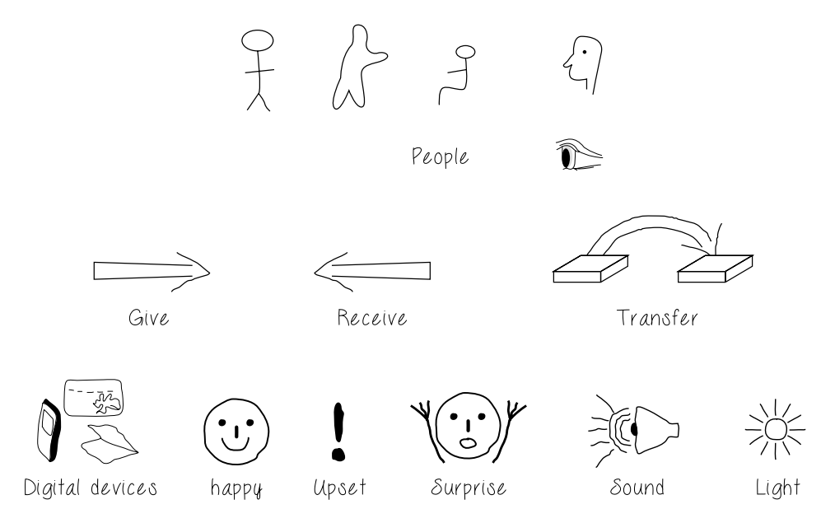
Sketching - LFP
“Sketching is not about drawing. Rather, it is about design” - Saul Greenberg et al. (2012)
Elements
digital devices, people, emotions, tables, books, various icons, dialog boxes
Actions
give, find, transfer, and write.

Slide 25
Index Cards - LFP
Index cards (small pieces of cardboard about 3 × 5 inches) is a successful and simple way to prototype an interaction
It is used for developing a range of interactive products (websites and smartphone apps).
Each card represents one element of the interaction, perhaps a screen or just an icon, menu, or dialog exchange.

Slide 26
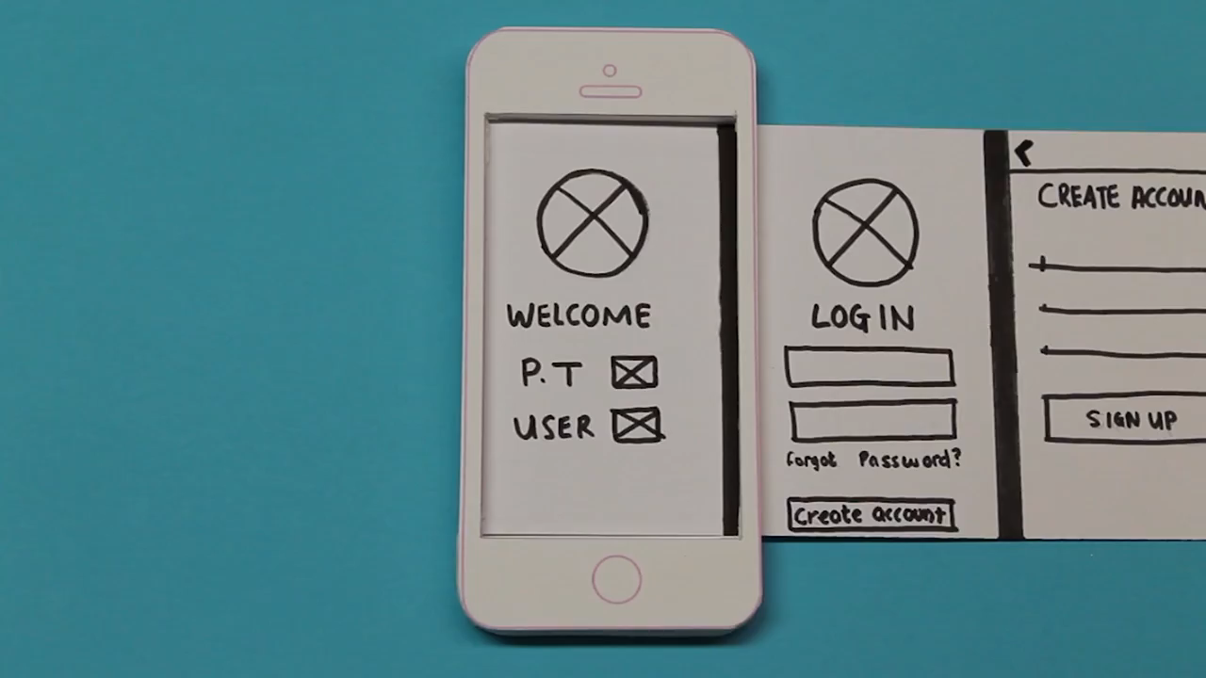
Example

Slide 27
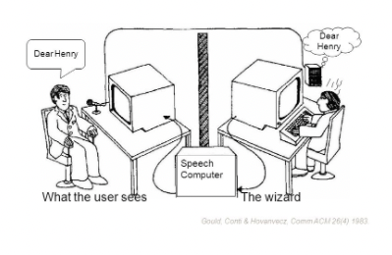
Wizard of OZ - HFP
Wizard of Oz assumes that you have a software-based prototype.
With this technique, the user interacts with the software as though interacting with the product.
In fact, however, a human operator simulates the software’s response to the user.

Slide 28
High Fidelity Prototype
A high-fidelity prototype looks more like the final product and usually provides more functionality than a low-fidelity prototype.
High-fidelity prototypes can be developed by modifying and integrating existing components
i.e. developer kits and open source software
Can be evaluated “in situ”.

Slide 29
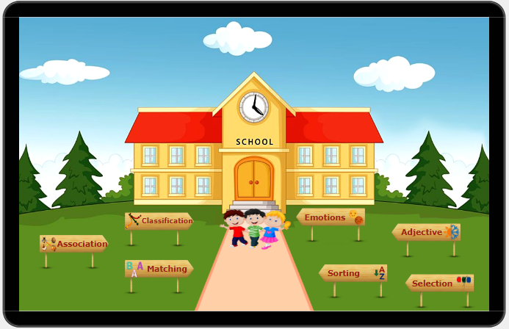
Example
A prototype of an educational game for children with autism - build in Just in Mind

Slide 30
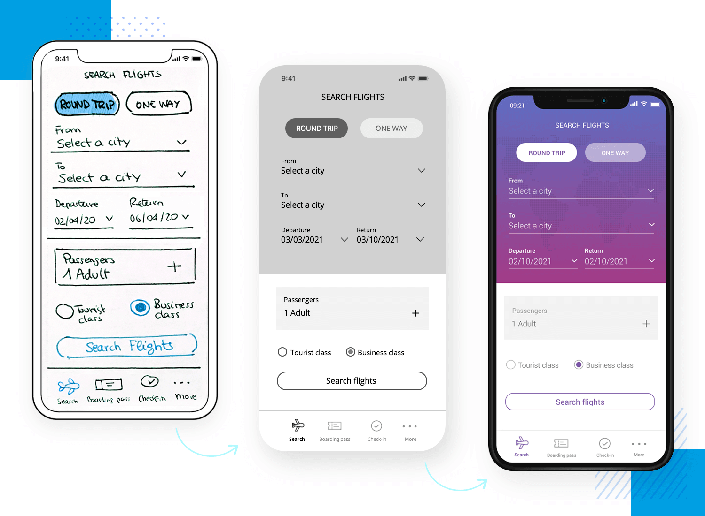
Example

Slide 31
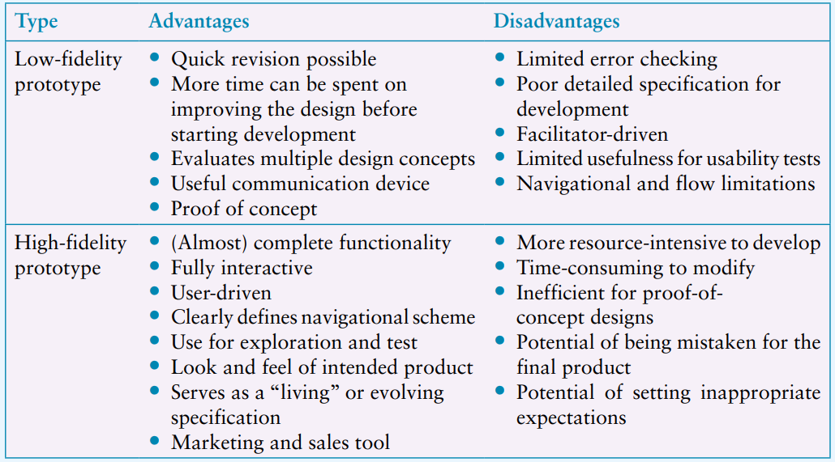
Compromises in Prototyping

Slide 32
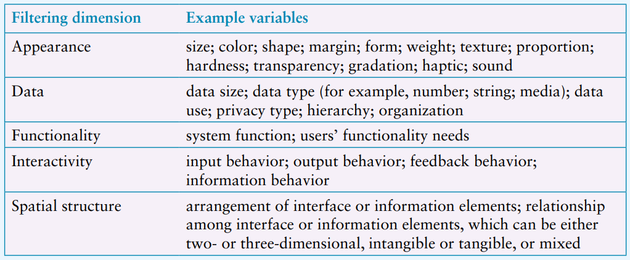
Development Dimensions to Consider

Slide 33
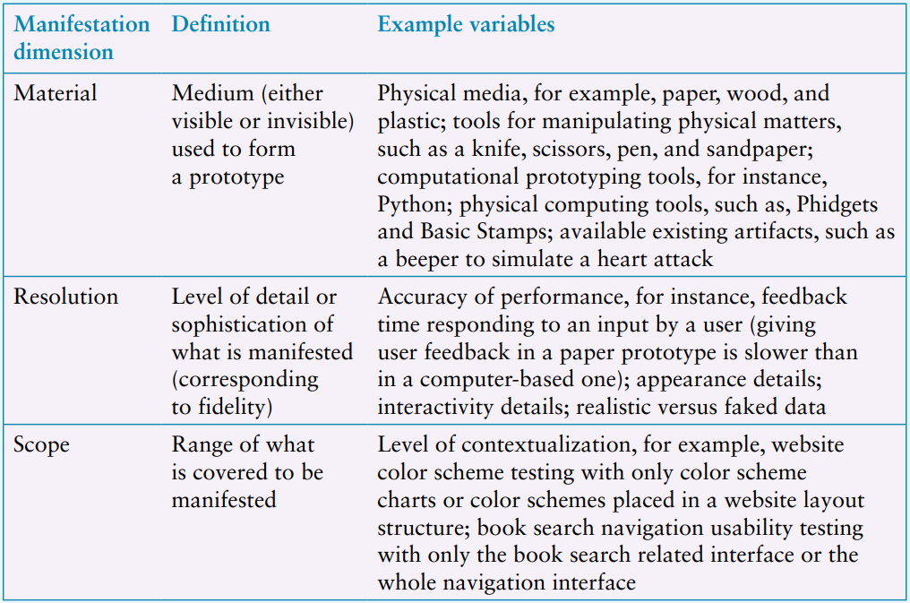
Development Dimensions to Consider

Slide 34
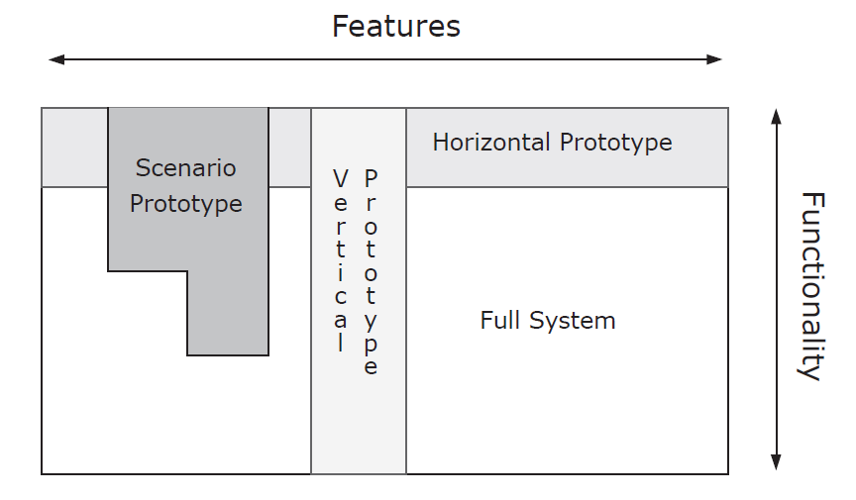
Development Dimension Trade Offs
Breadth of functionality versus depth
Horizontal prototyping (providing a wide range of functions but with little detail).
Vertical prototyping (providing a lot of detail for only a few functions).
Robustness versus degree of changeability.
Making a prototype robust may lead to it being harder to change.

Slide 35
Evaluation and Prototypes
Evolutionary prototyping
A prototype evolves into the final product and is built with engineering principles in mind.
each stage is subjected to rigorous testing
Throwaway prototyping
uses the prototypes as stepping stones toward the final design. In this case, the prototypes are thrown away, and the final product is built from scratch.
testing is not necessary.

Slide 36
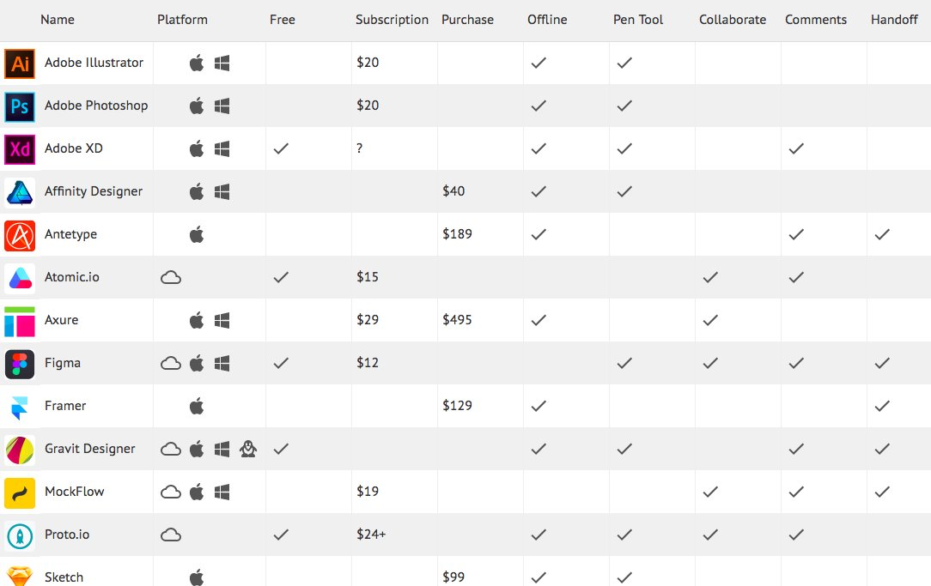
Tools for Prototyping

Slide 37
Construction
It is unlikely that anything will need to be developed from scratch.
There are two useful (in some cases essential) among many resources to support development.
Physical computing kits
Software development kits (SDKs)

Slide 38
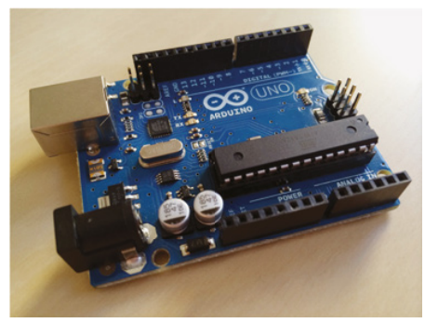
Physical Computing
Physical computing is concerned with how to build and code prototypes and devices using electronics.
The Arduino board

Slide 39
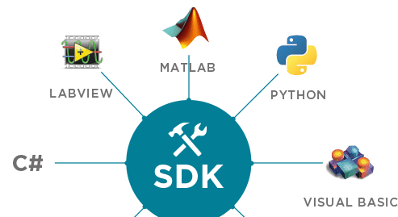
SDKs: Software Development Kits
A software development kit (SDK) is a package of programming tools and components that supports the development of applications for a specific platform.

Slide 40
Conclusion
Conceptual Design
Concrete Design
Prototyping
Construction

